Slide 1
Forensics for the body farm: Preferences for the medicinal blow fly (Phaenicia sericata, Lucilia sericata) and fruit fly (Drosophila melanogaster)
Introductions of project developers:
Oscar Istas (University of Kentucky)
Abigail Greenhalgh (University of Kentucky)
Rebecca Krall (University of Kentucky)
Erin Richard (University of Kentucky)
Jate Bernard (University of Kentucky)
Diane Johnson (EKU Partnership Institute for Math and Science Education Reform: Morehead, KY)
Tawny Aguayo-Williams (University of Kentucky & High School teacher to implement for class project)
Robin Cooper (University of Kentucky)

Slide 2
The overall plan is to integrate observations, make predictions based on evidence, literature research, creativity, design, and conduct experimentation for this activity. This module is a story-based, authentic course for undergraduate research experience (ACURE) as well as targeted for high school level. As a substitute for bringing decaying meat with maggots, for the workshop, we simulated the experimental design with plastic tags of larvae in different developmental stages, and flies for the two species. Predictions and discussion will occur addressing the life cycles stages and environmental effects on development, such as temperature, and how this can change depending on the number of larvae present.
The theme for the investigation is a human has taken a bite of a fruit before dying out is a rural farm field.
- Fruit flies as well as blow flies are found at the scene.
- Investigation takes place into the location and developmental stages of the insect larvae and pupa. Data and details are provided for participants to work with in determining the time frame of the person died without or with experimentation.
- Protocols are provided to recreate the scene with physical modeling.
- Variations in the experimentation are detailed with agar plates and food for insect developmental studies.

Slide 3
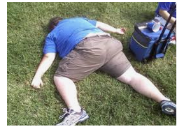
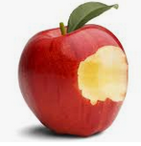
Forensic case
Person found (dead).
Apple with a bite take out of it.
Open grassy field.
Grass wet –weather conditions will be collected.
Last couple days (hot is daytime, cooler nights)

Slide 4
Flexible tasks for teachers
The activity is divided into flexible tasks for teachers to adjust as needed but to provide a logical framework for stepwise learning.
Task 1: Look over the data provided and come up with a list of items worthy of learning more about the insects and other information to estimate the time in which the animal/person might have died.
Students make lists and then write them out on a board and see how many of the same items were chosen.
Task 2: Examine the literature and web sources to find the life cycle of fruit flies and blow flies as well as related to forensics. Topics to pay attention to: Temperature, food source, crowding, stages and how to tell the stages as well time within a stage.
Task 3: Compile the data provided to estimate at minimum how long the body and fruit must have been present.
Put a timeline together based on the developmental stages of the insects. Back date down to egg laying and list air temperatures with the dates (day/night).
Optional- Task 4: Set up a simulated science with a cut apple and beef liver and add fruit flies as well as blow flies. Conduct experiments at room temperature and monitor developmental stages.
Optional- Task 5: Set up isolated fruit flies and blow files in separate containers with food. Use incubators to simulate temperature changes and monitor developmental stages.

Slide 5
Task 1
Body: Body temperature, condition of corpse (skin broken or intact), insect larvae inside body or only around mouth and eyes, are body fluids leaking out, dehydrated, hair falling out, grass/plants underneath dead or look fresh or still green, insects under body, wild animal bites from dogs or other large animals, insects associated with body. If insects present what stages eggs to pupa.
Apple: dried out or moist, bacteria, fungi, insects present. If insects present what stages eggs to pupa.
Environment: Temperature of the last few days, rain, wind.

Slide 6
Task 2
Google searches on:
Life cycle Drosophila
Life cycle blow flies (Phaenicia sericata)
How to stage larvae, temperature effects on insect development
How to determine how long a animal is dead, forensics dead animal, forensics insects.

Slide 7
Task 3
List out the stages of the two different types of larvae, eggs, pupa and if pupa cases eclosed.
Try to make developmental curve based on temperatures.
Back calculate the potential dates that the person and apple were exposed to the open environment.
Use Netlogo simulation to examine how fast a population can grow depending on number of adults and sex of adults.

Slide 8
Task 4
Go over set up in how to simulate the scene with mixed fly species and be able to monitor the food sources and insect development.
Task 5
Go over set up in how to investigate individual fly species and effects of environment on developmental cycle in controlled environments.

Slide 9
Task 4
Go over set up in how to simulate the scene with mixed fly species and be able to monitor the food sources and insect development.
Outside simulation:
Need a cage to keep other animals from running off with content.
(easy to bring indoors)
Semi closed or could use wire and make it open.
(more natural).

Slide 10
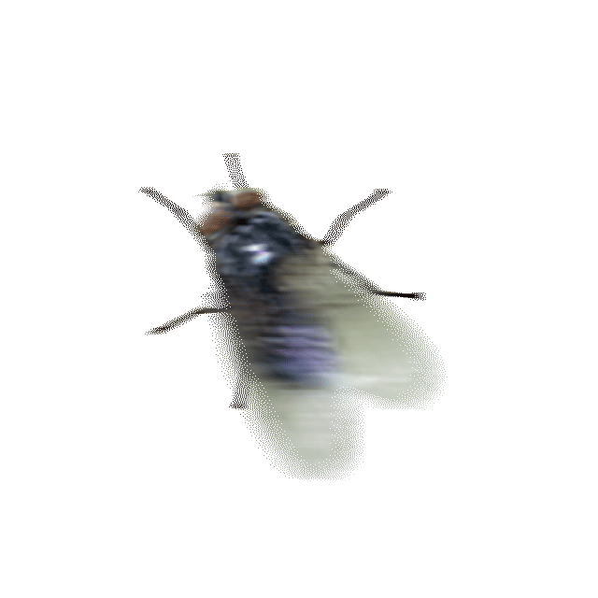
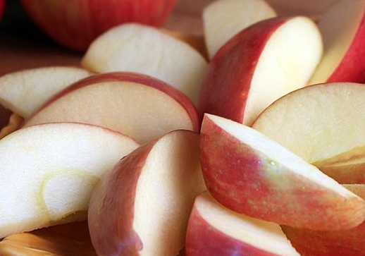
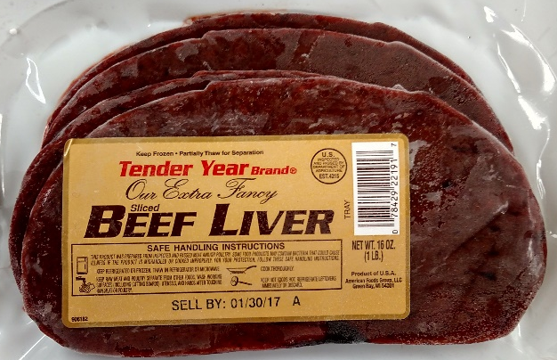
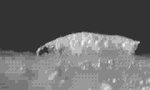
Different species of flies
Fly cage:
Indoor (managed)
or
outdoor (native flies)
EGG laying
Adult selectivity
and
Larval selectivity

Slide 11
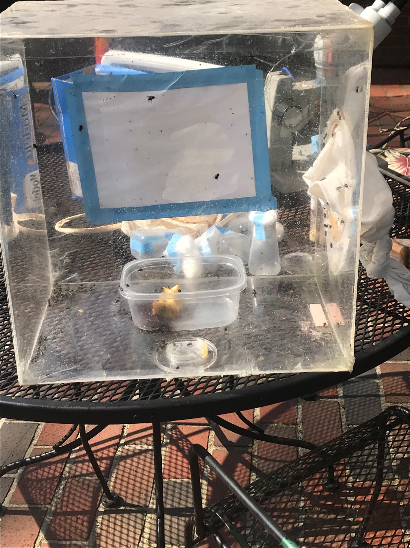
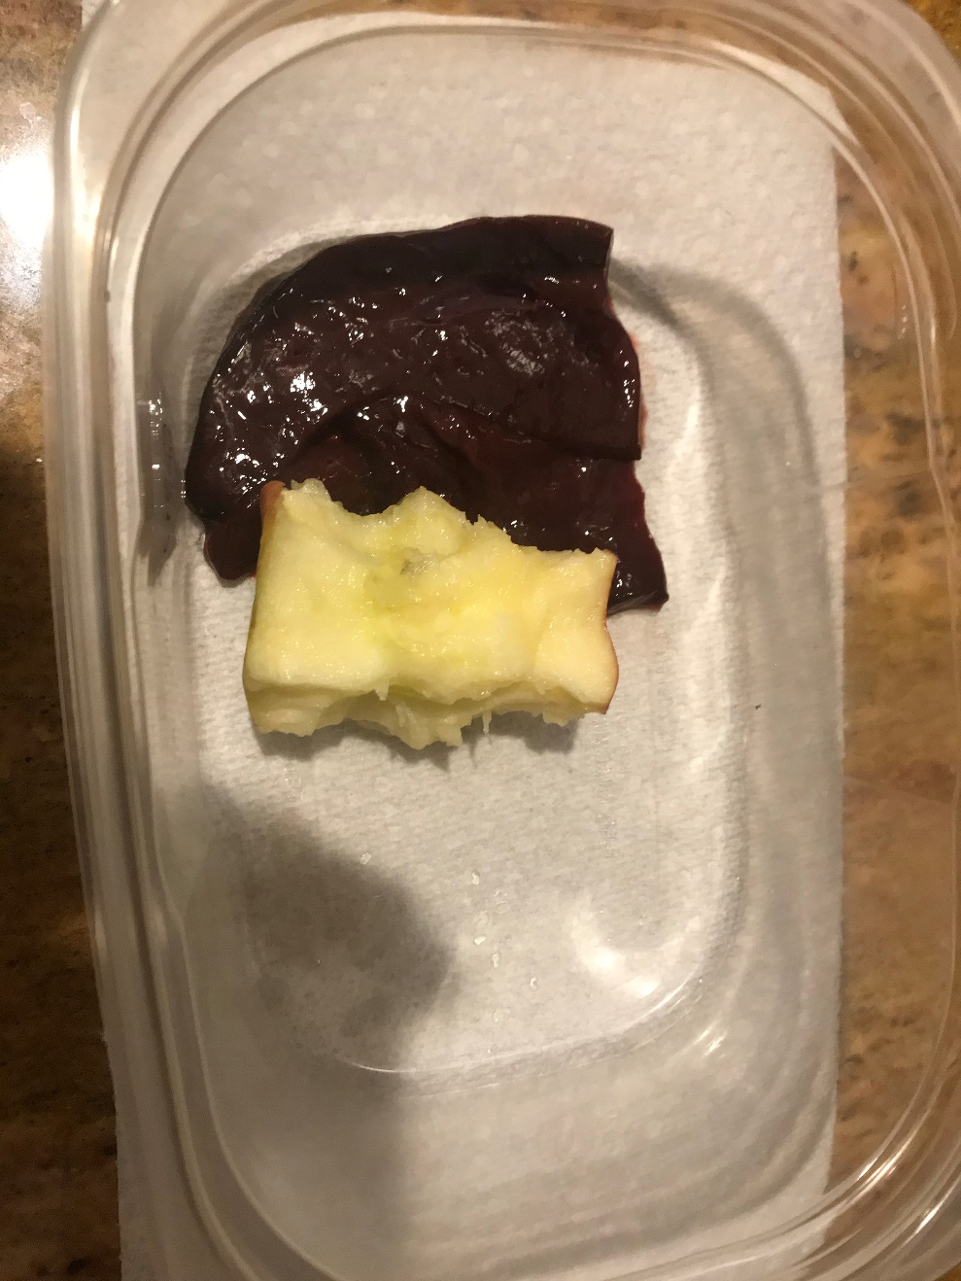

Slide 12
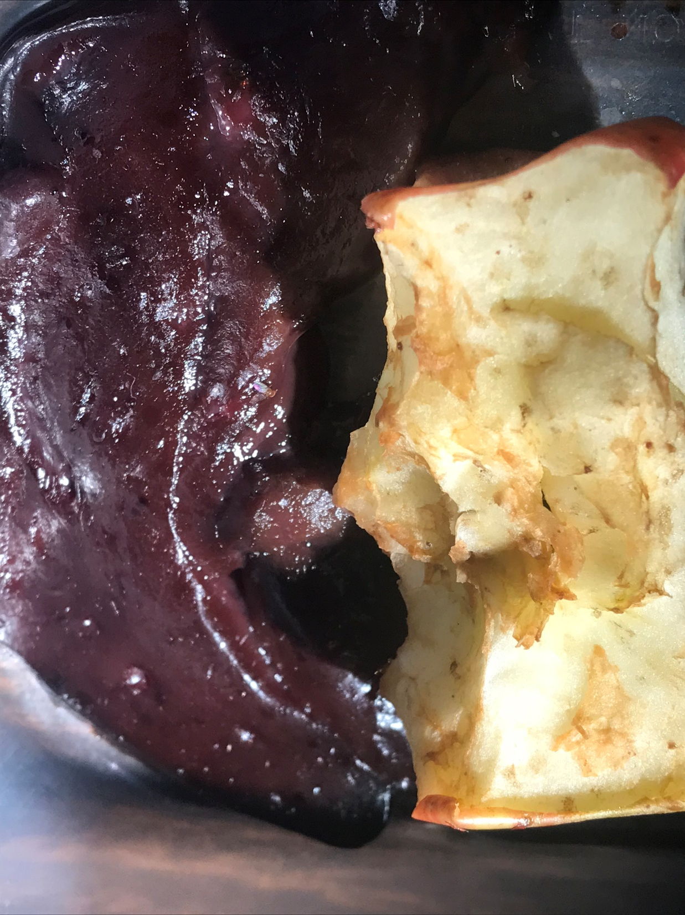

Slide 13
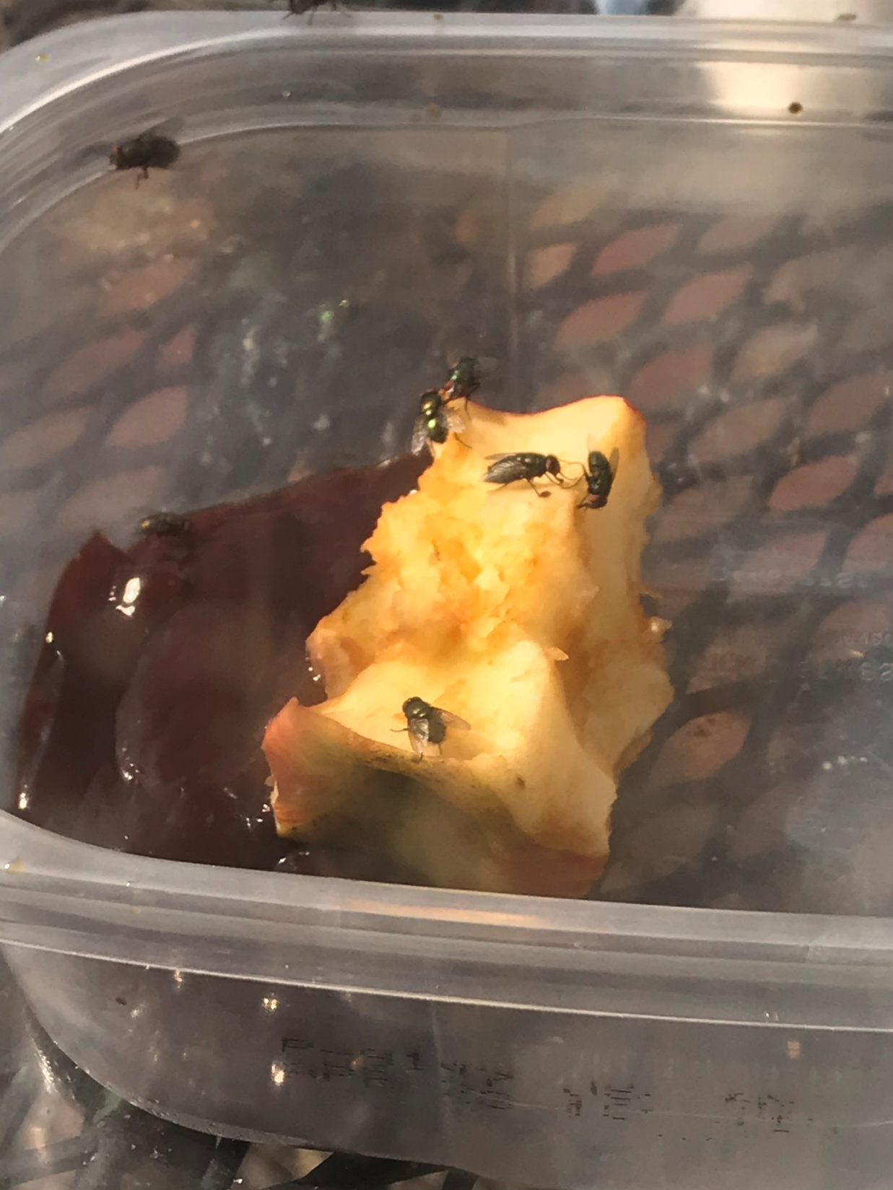
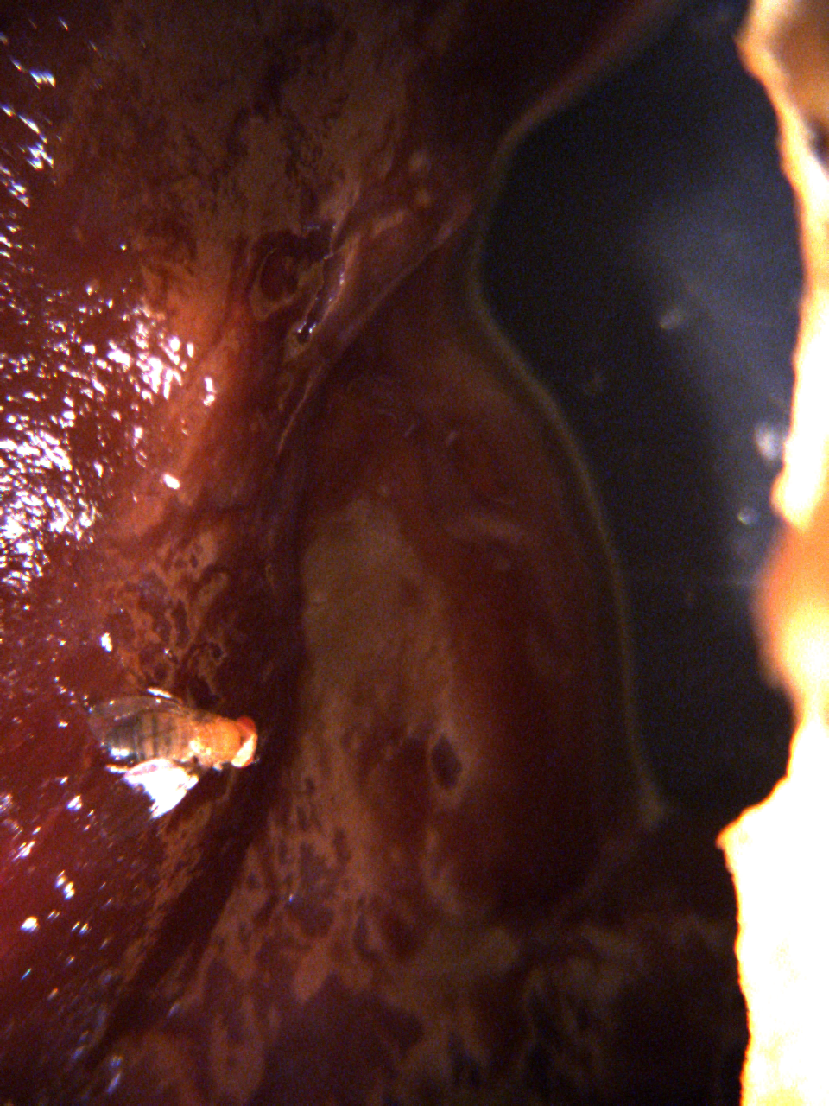

Slide 14
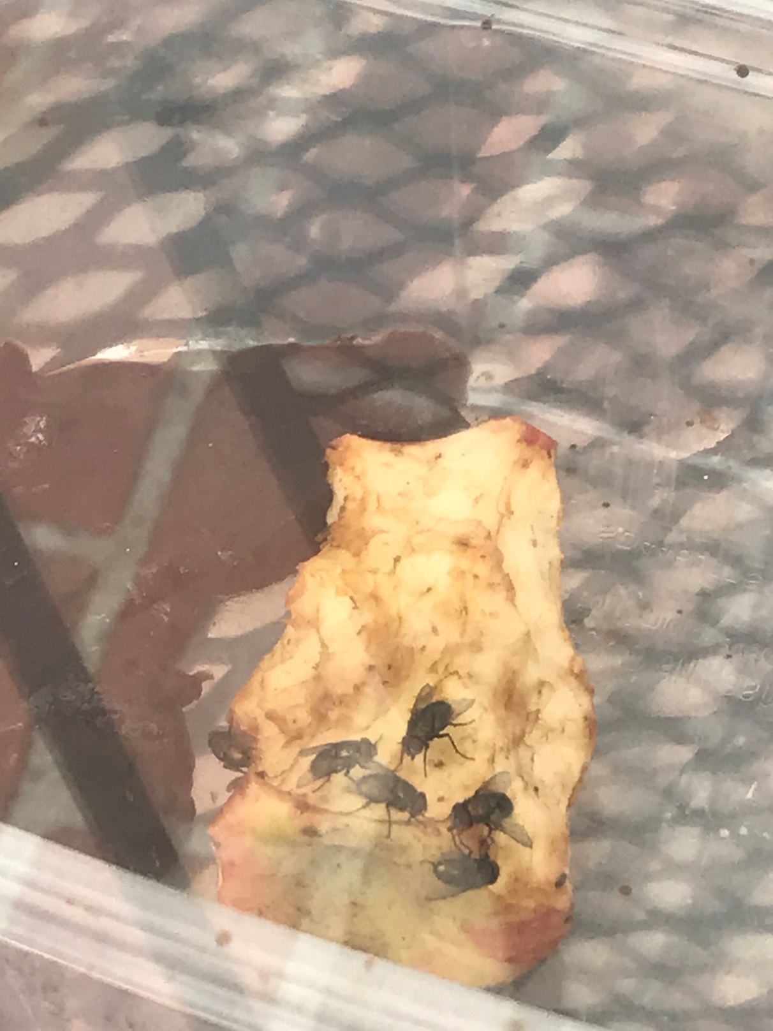
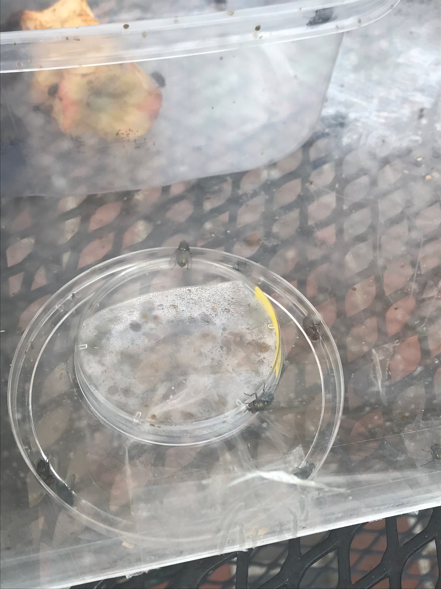

Slide 15
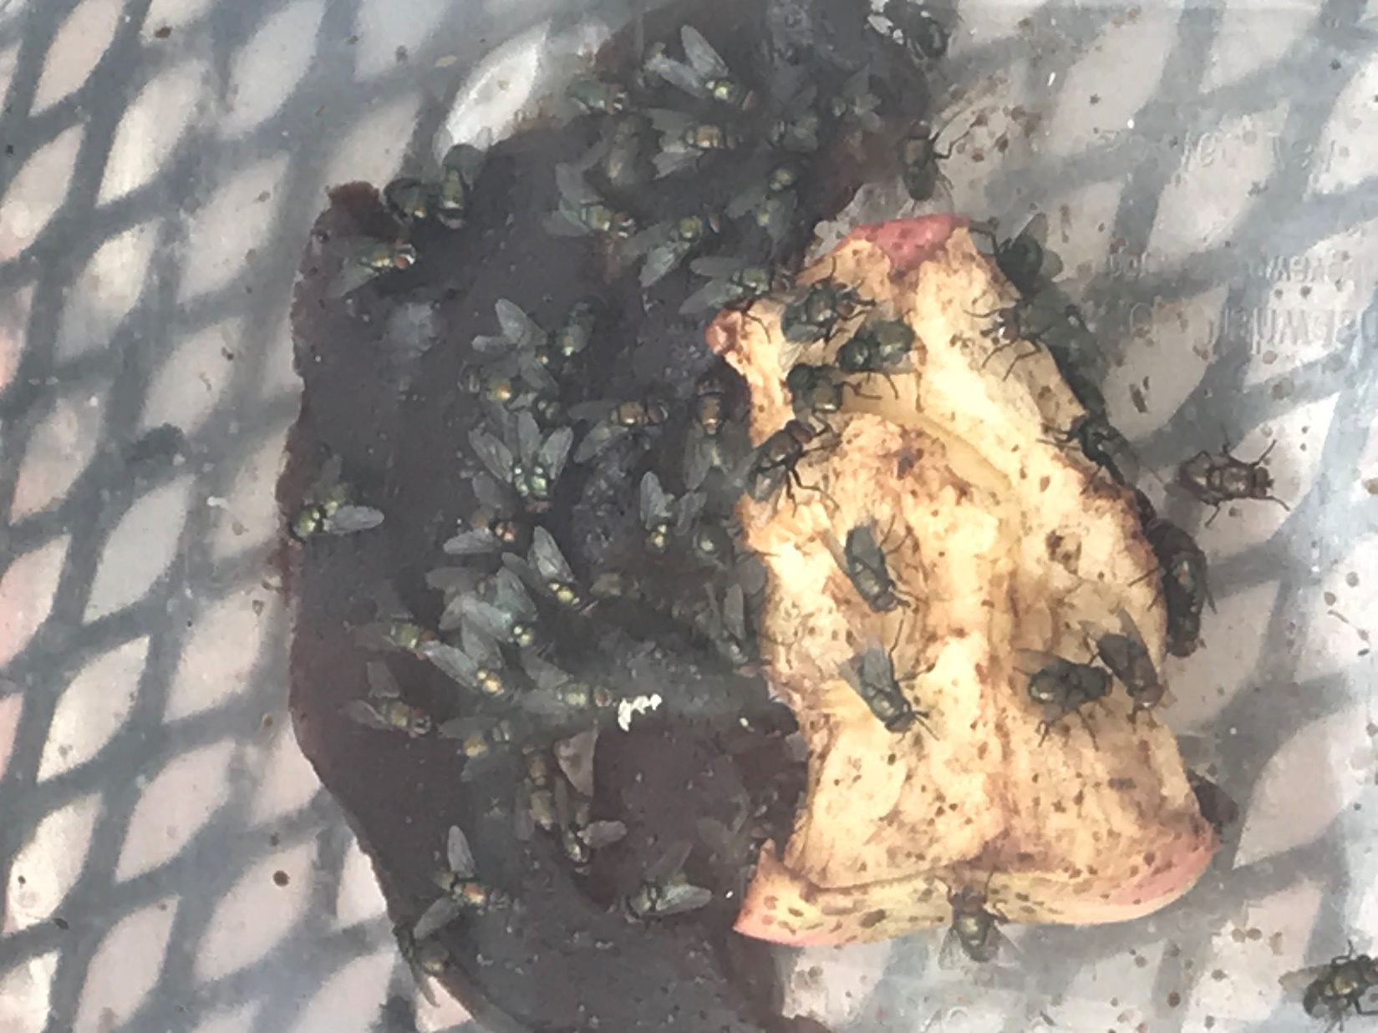
04062020

Slide 16
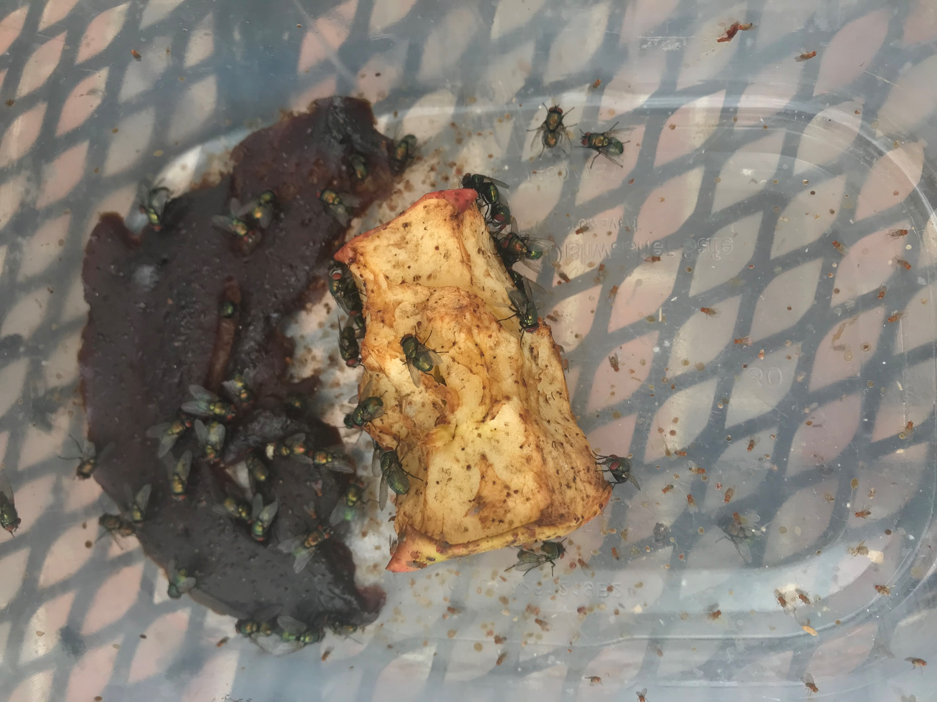
04072020

Slide 17
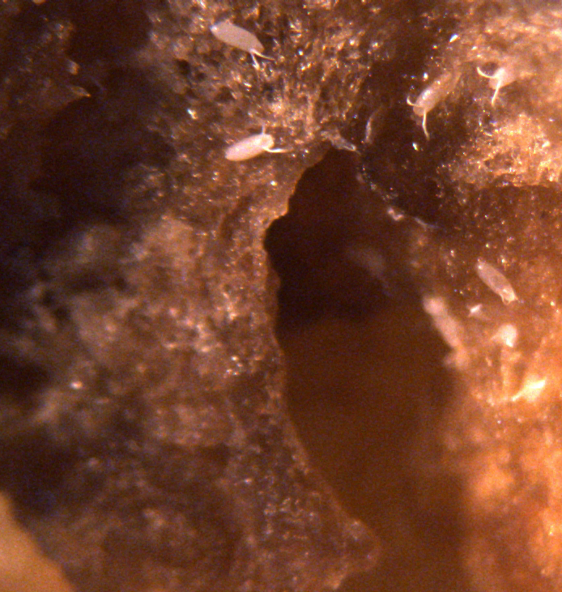
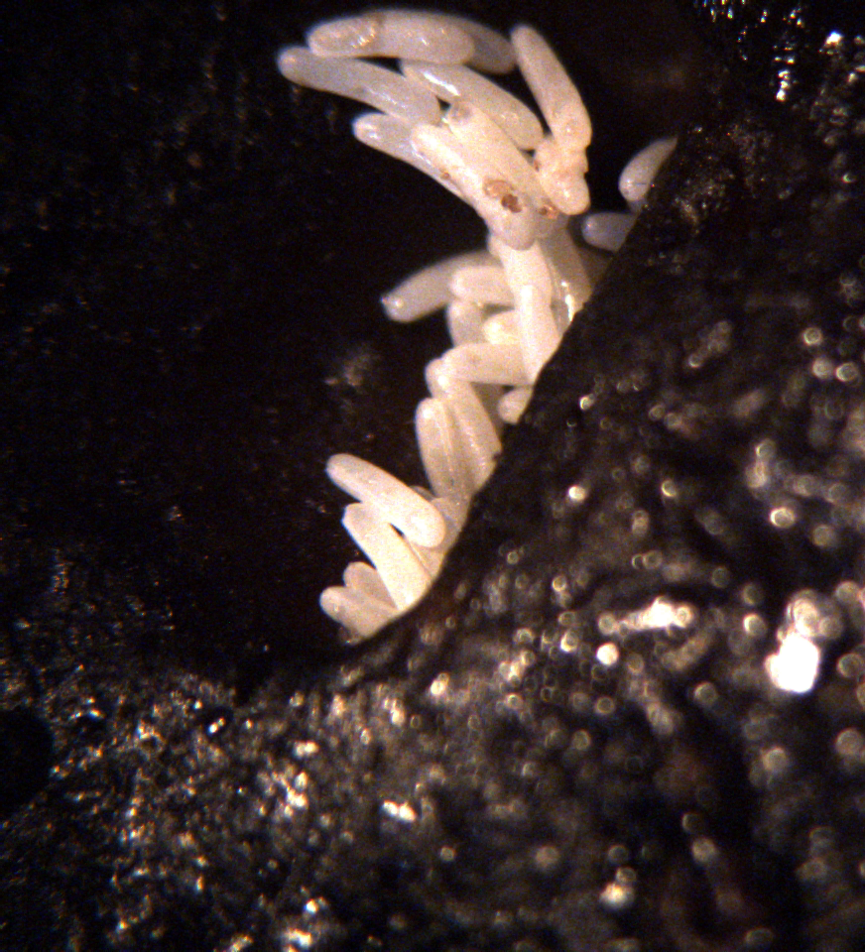
04072020

Slide 18
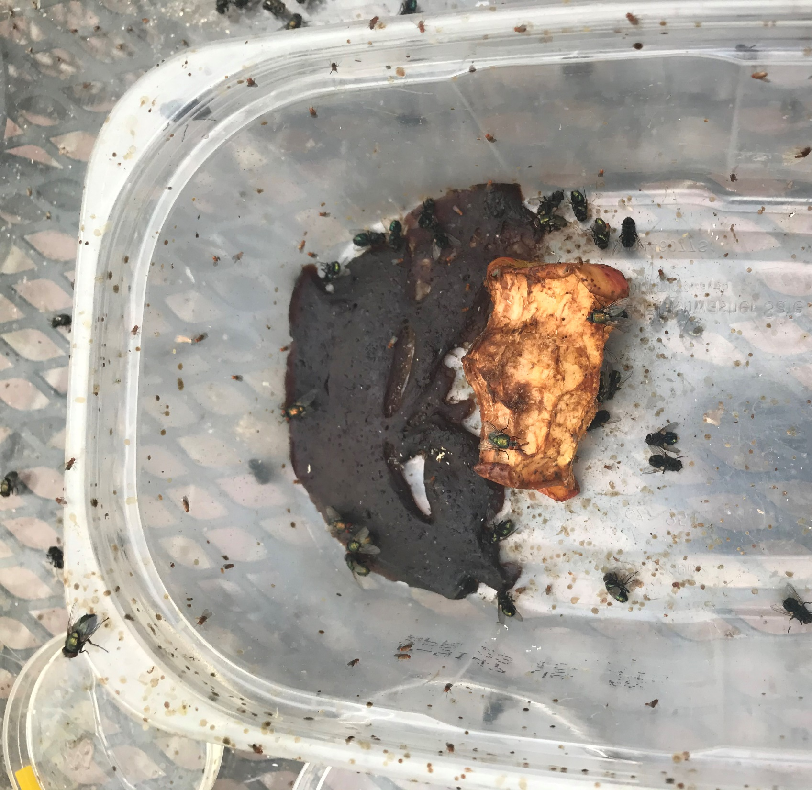
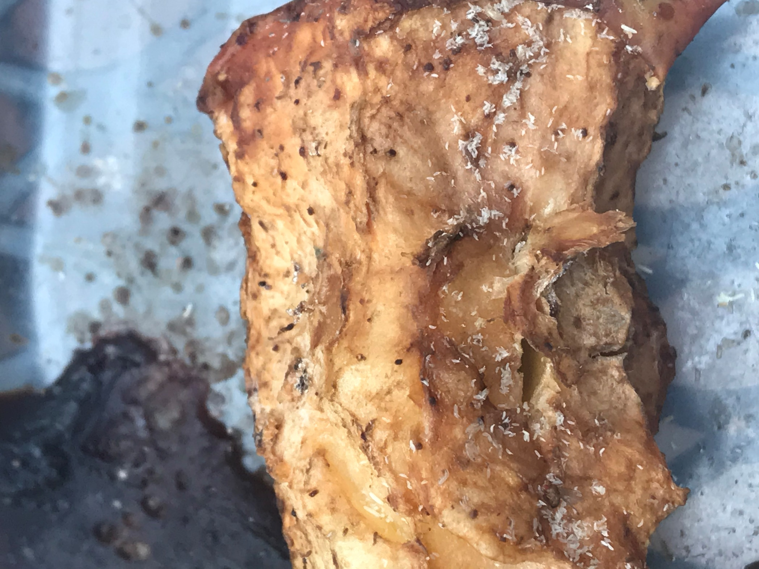
04082020

Slide 19
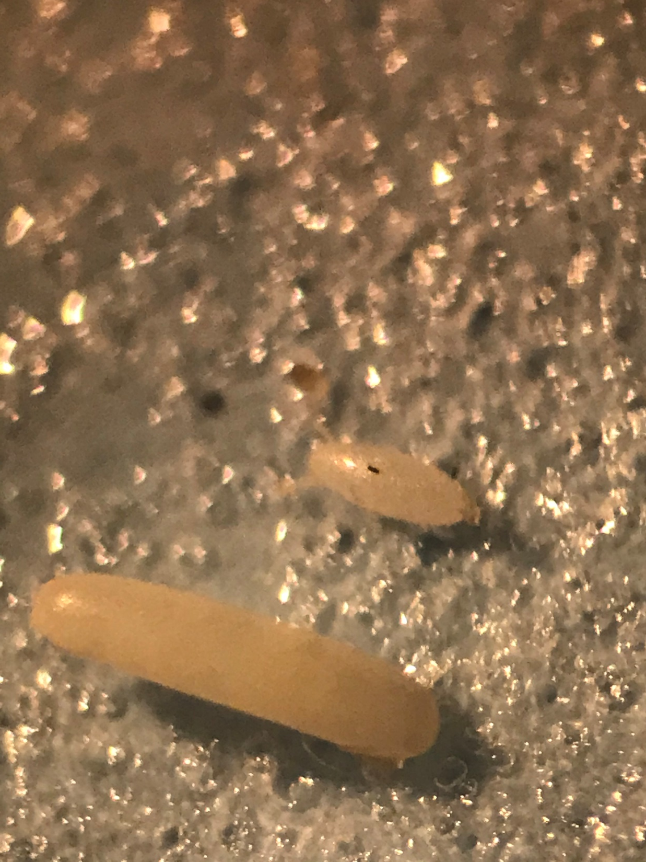
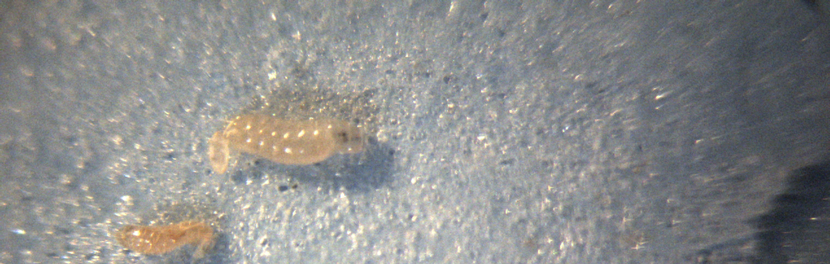
04092020

Slide 20
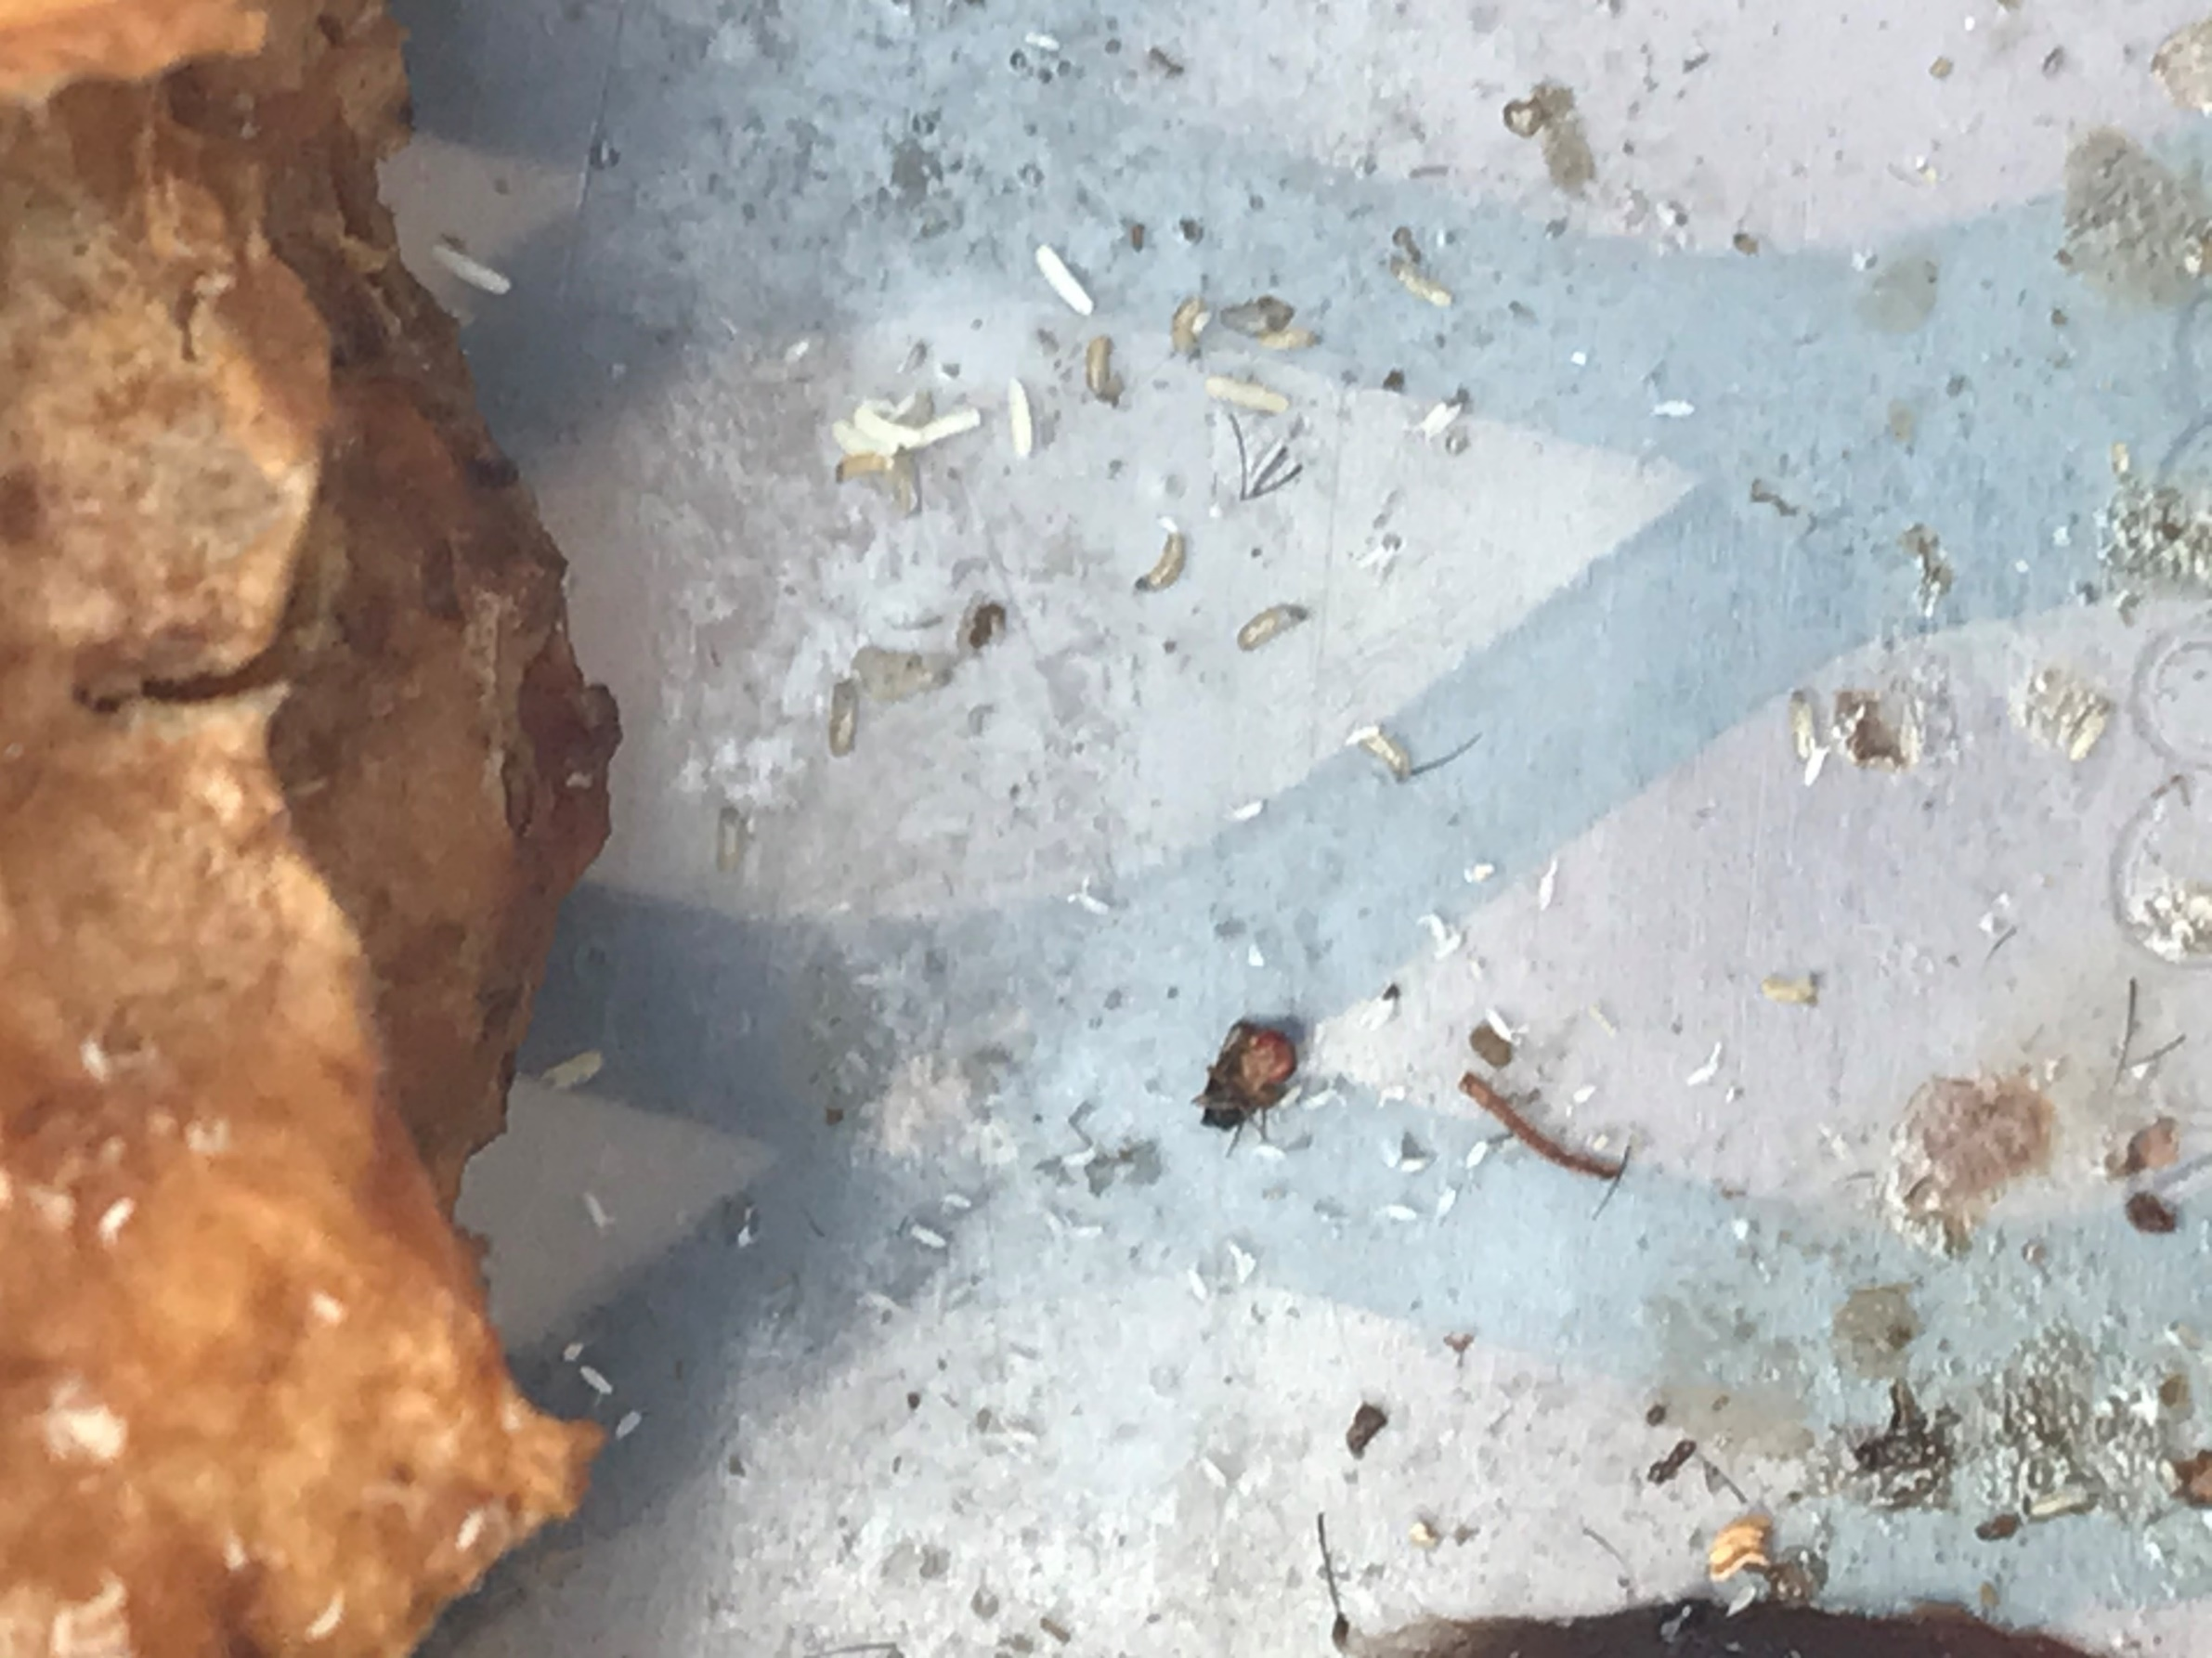
04092020

Slide 21
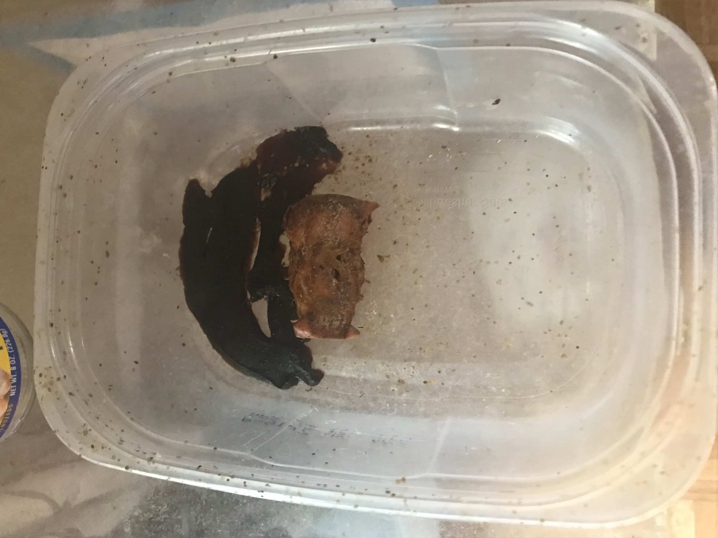
04102020

Slide 22
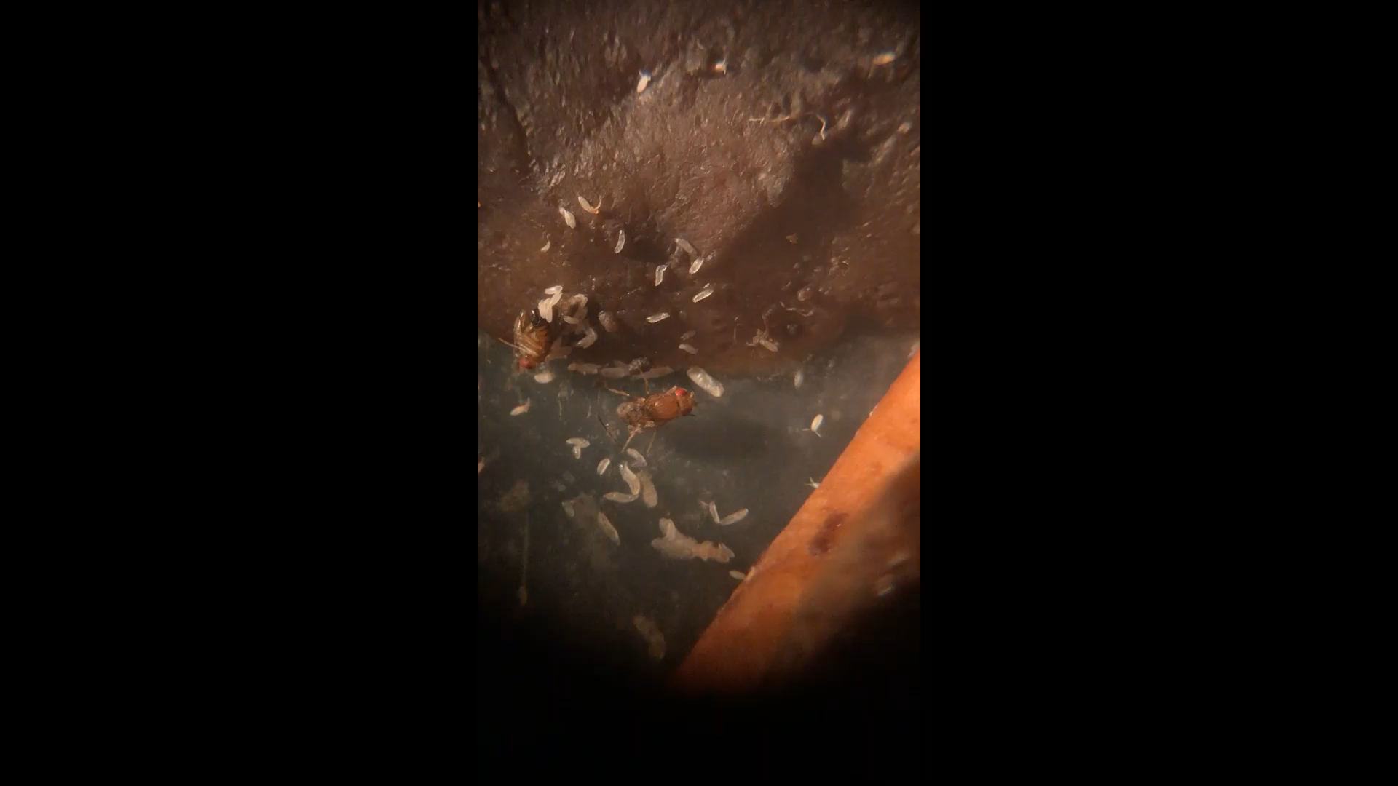
04102020

Slide 23
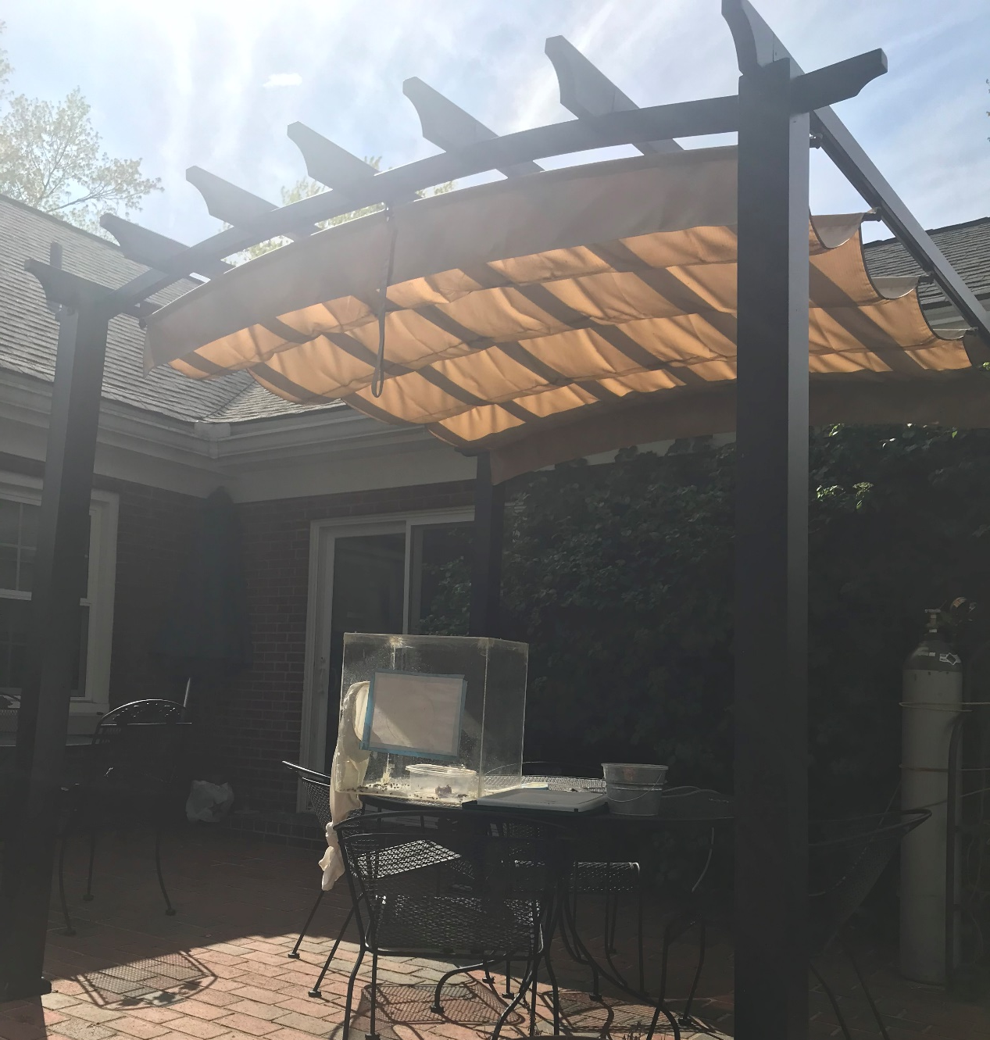
04122020

Slide 24
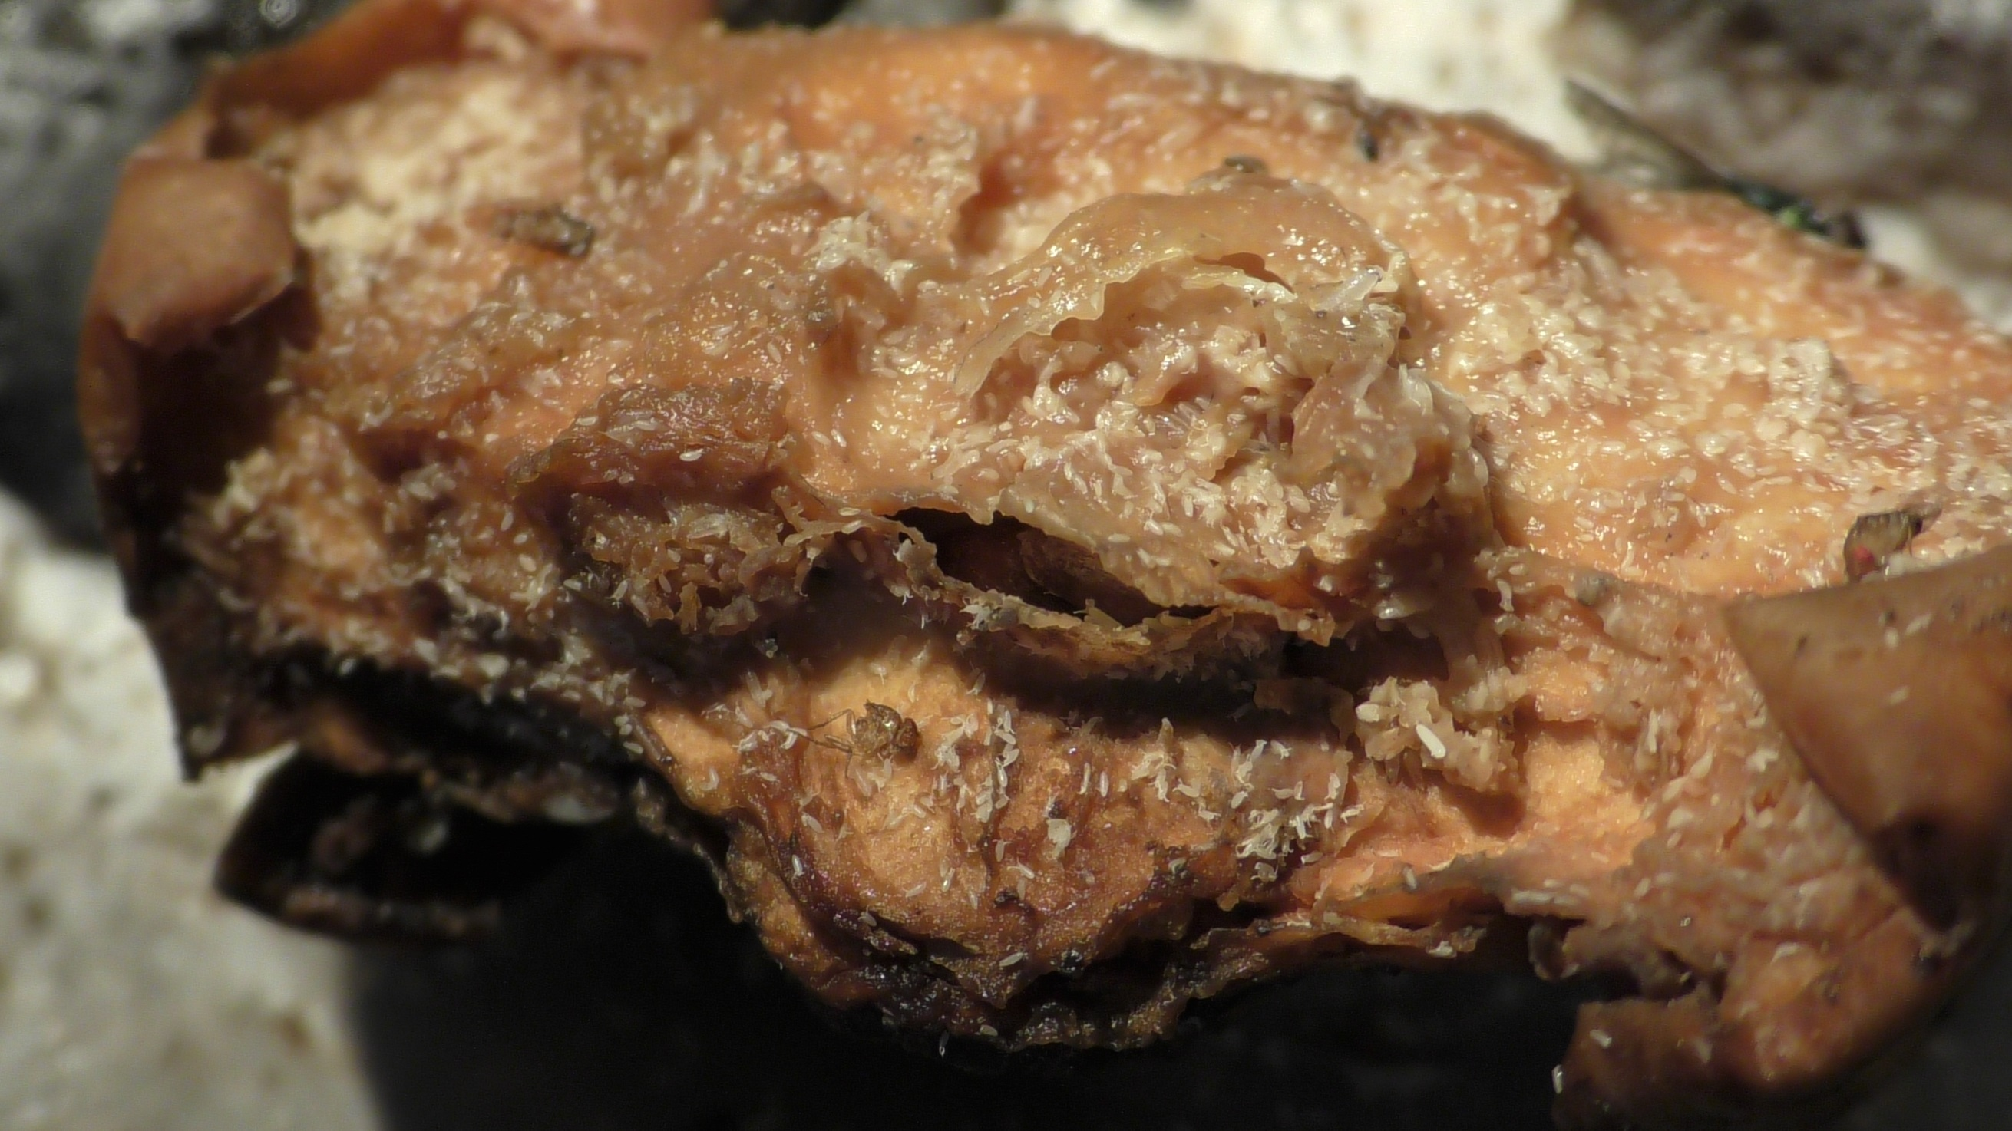
04122020

Slide 25
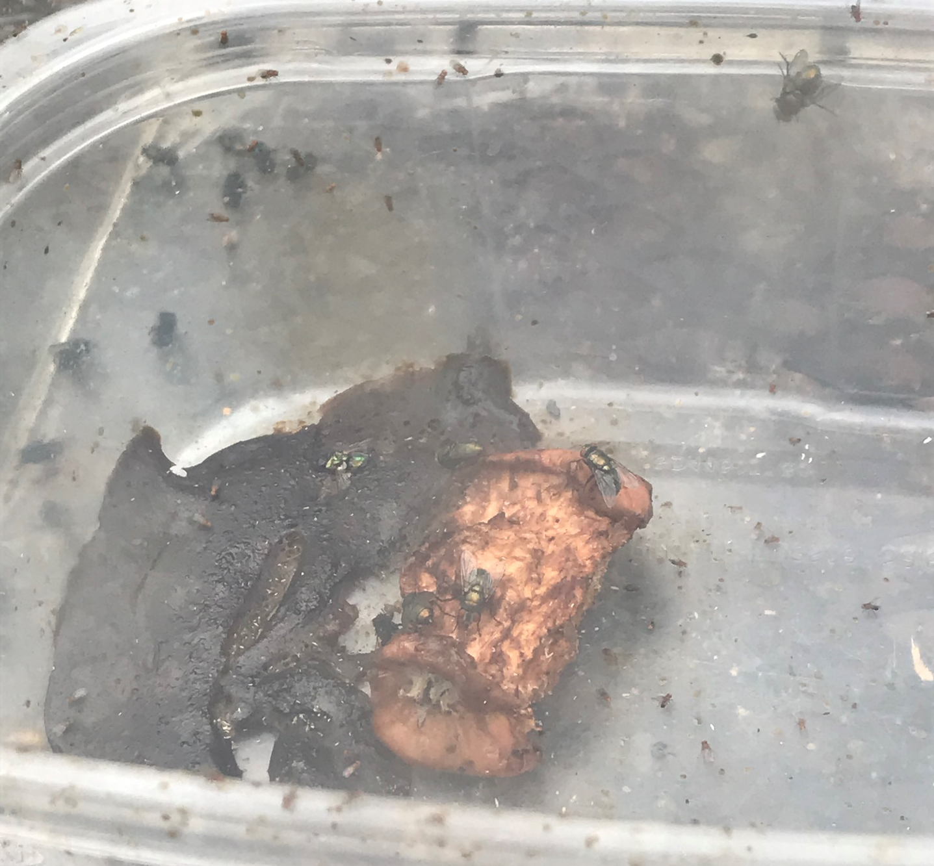
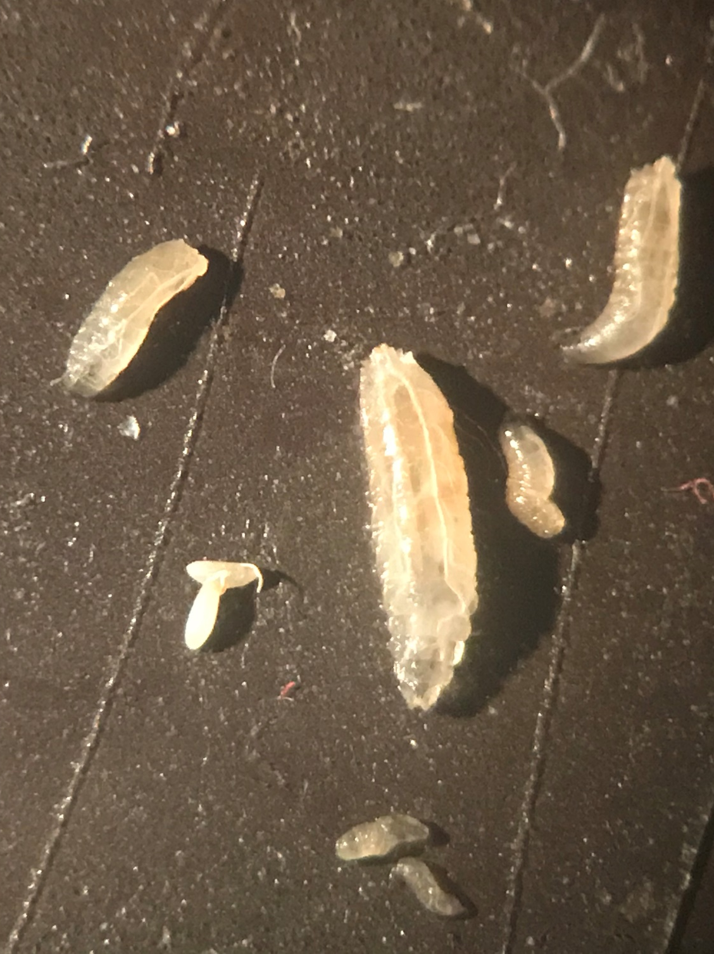
04122020

Slide 26
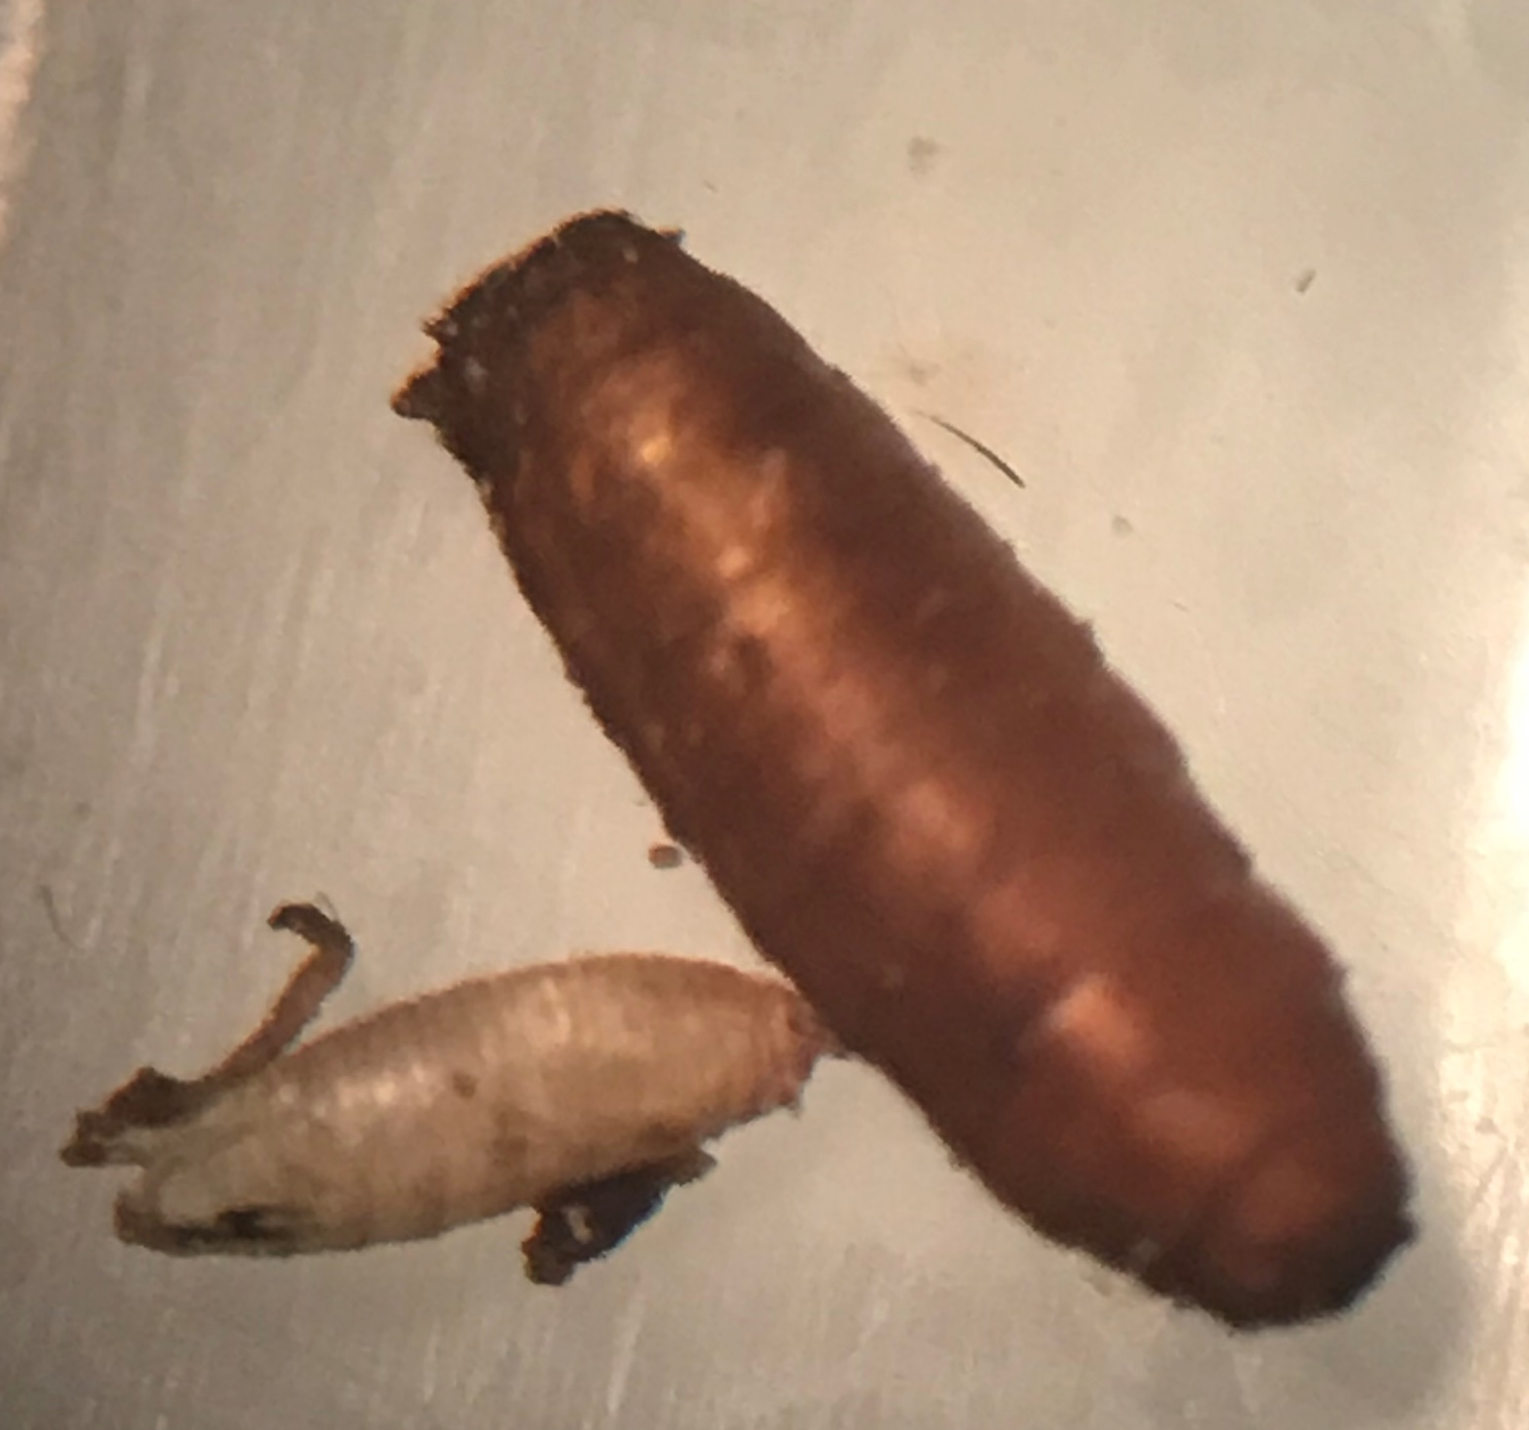
04122020
Blow fly and
Drosophila pupa

Slide 27
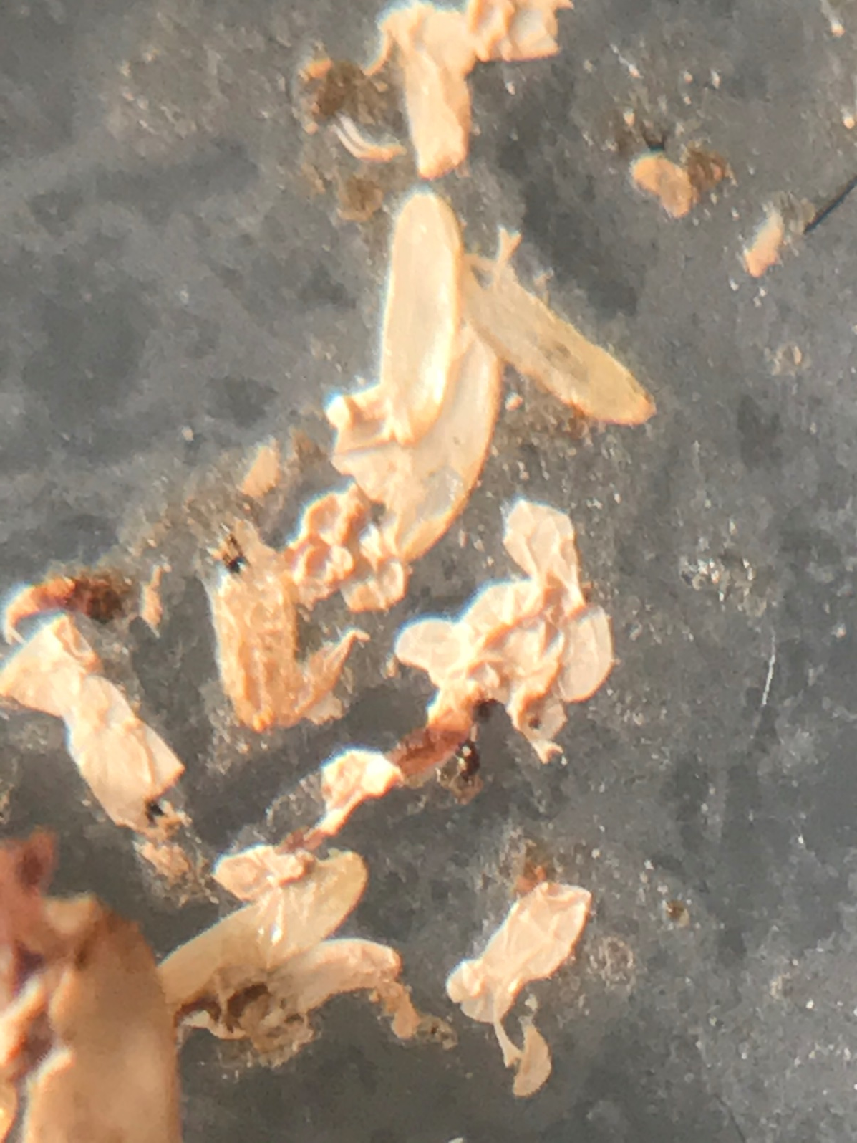
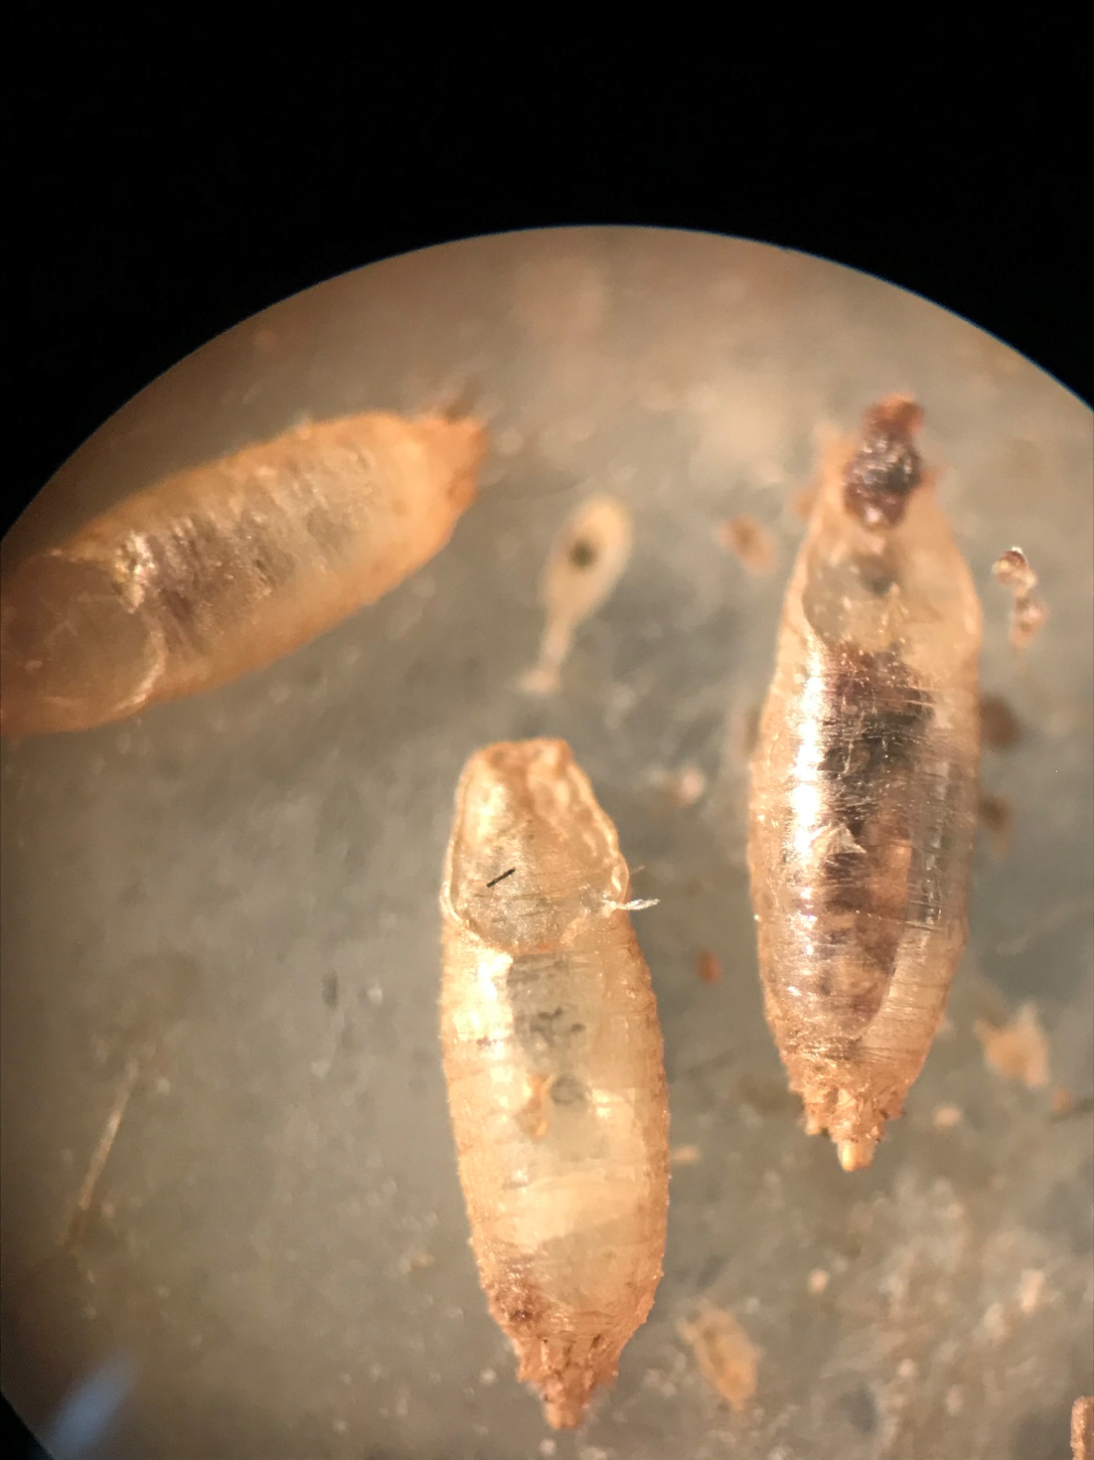
Egg cases
empty
Empty
and full pupa

Slide 28
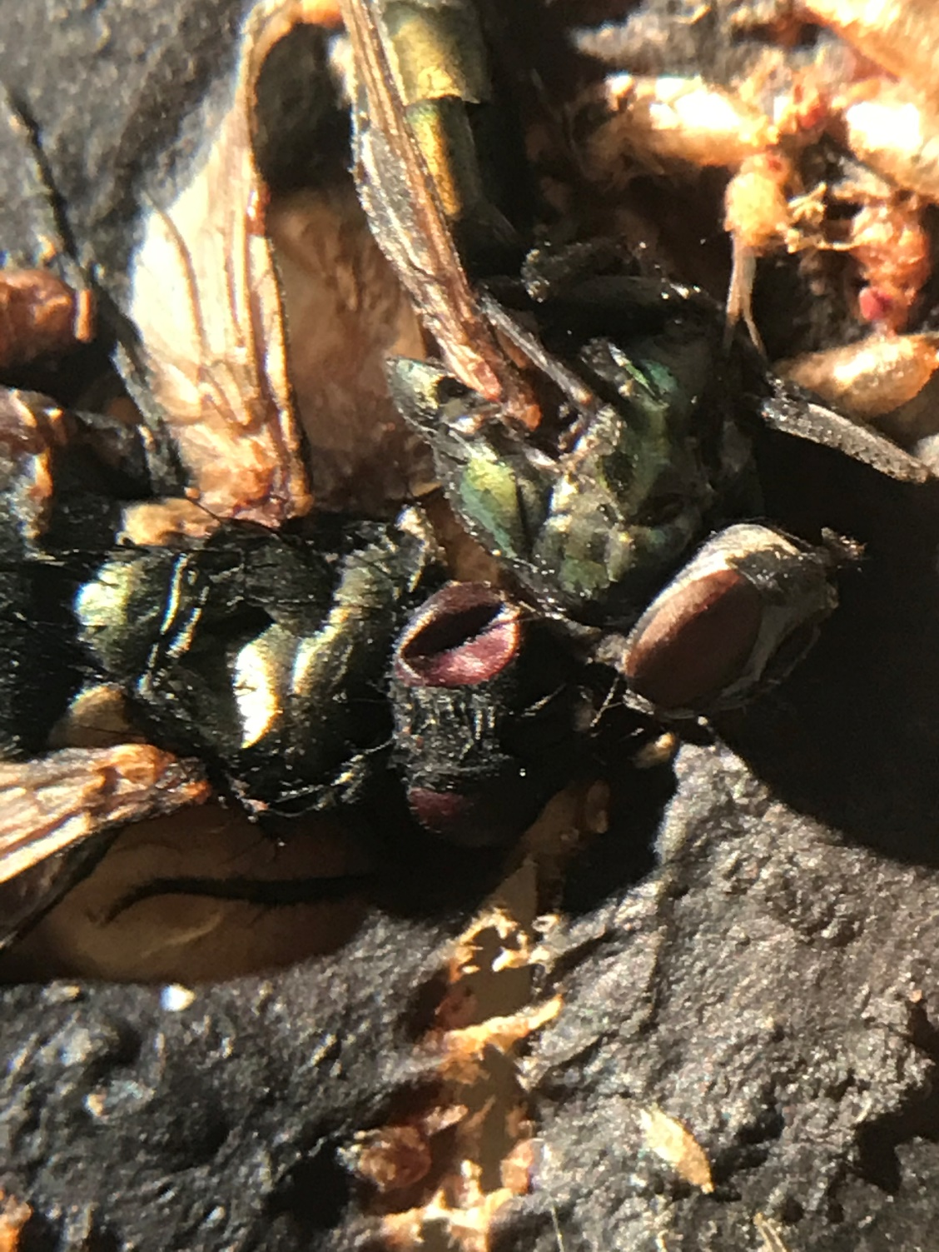
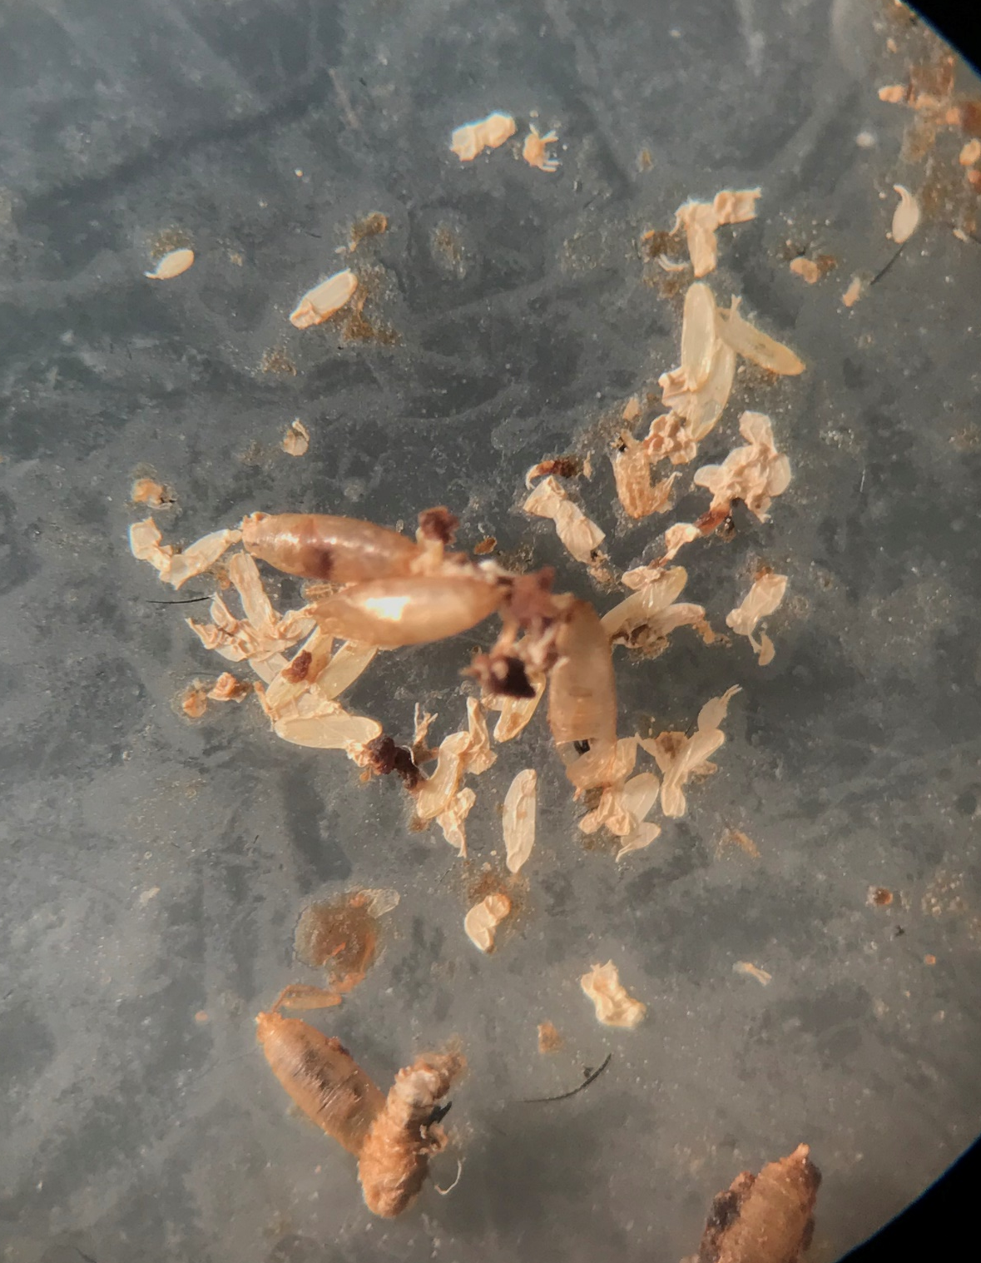
Extra
photos

Slide 29
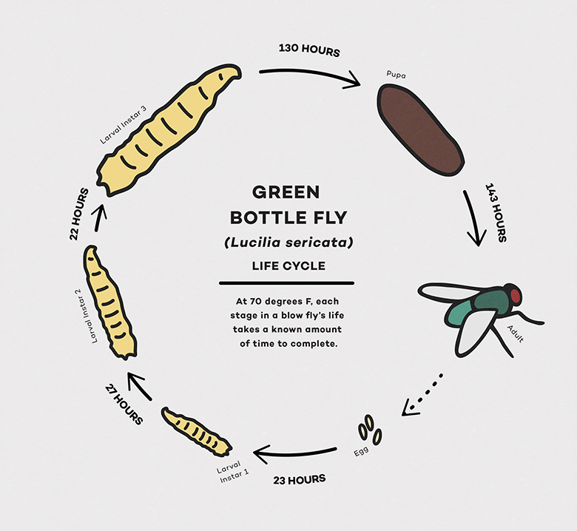
https://www.sciencefriday.com/educational-resources/forensic-entomology-body-farm/

Slide 30
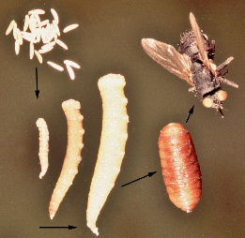
Life cycle:
Temperature effects
Lighting effect
Cover with leaves
Etc…

Slide 31
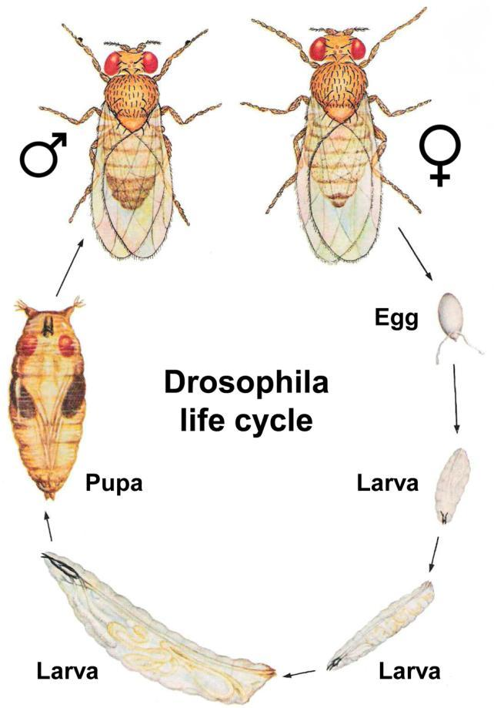
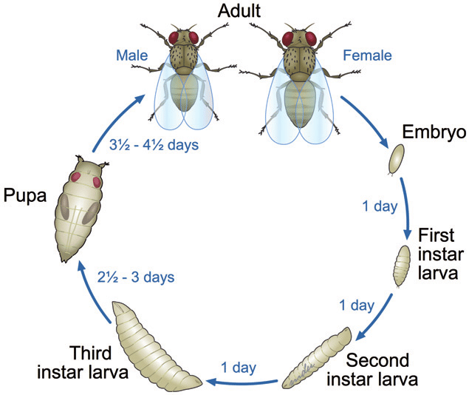

Slide 32
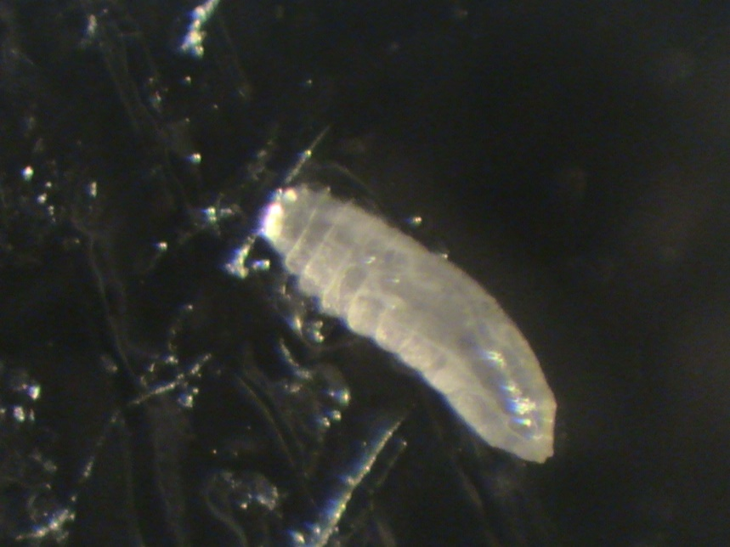
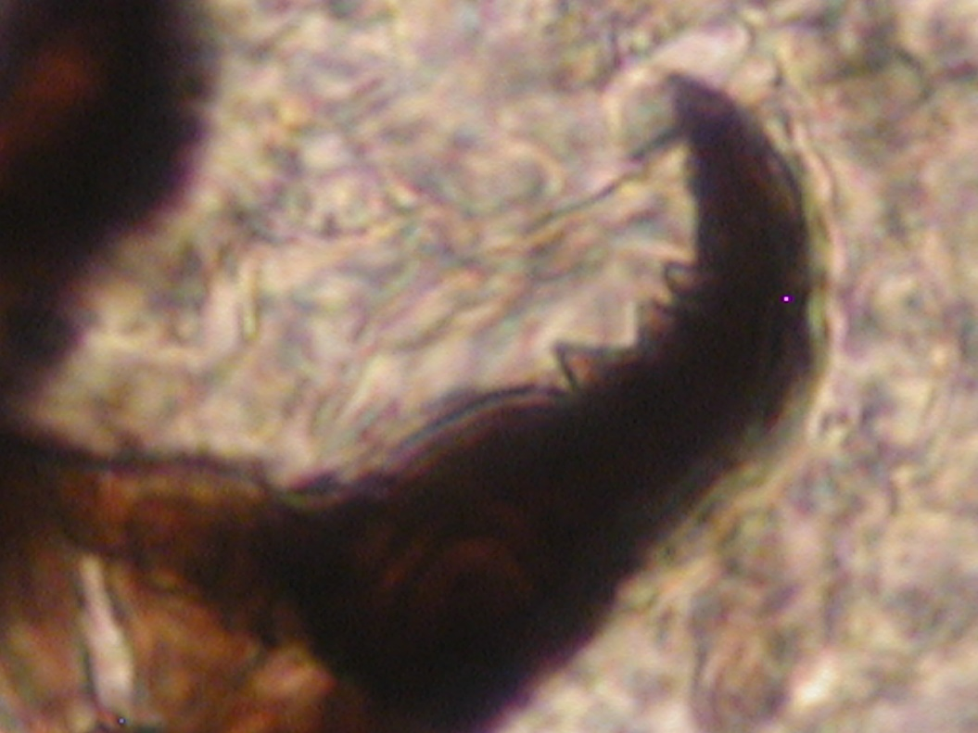
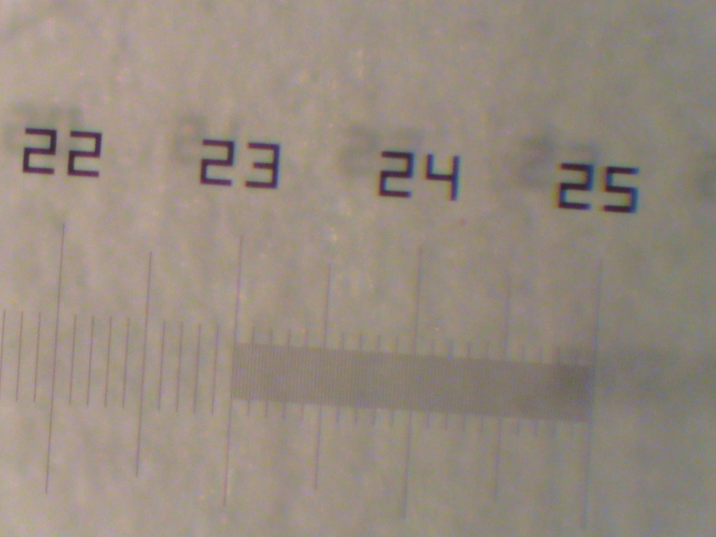
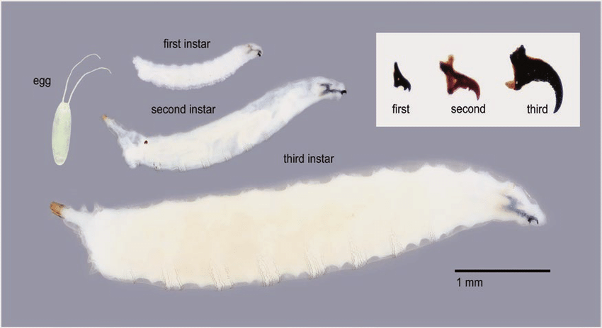
Lengths of larvae
in developmental
stages
Mouth hook types
for developmental
stages in larvae
Timmeren et al. (2017). Journal of Integrated Pest Management, 8.

Slide 33
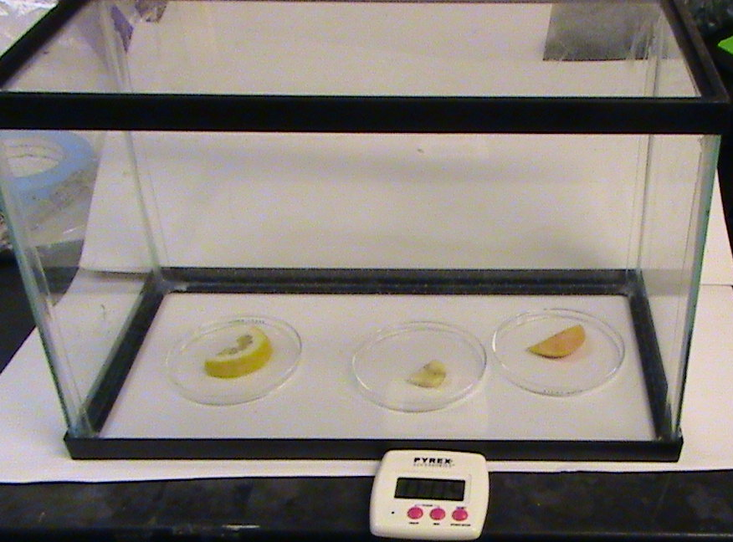
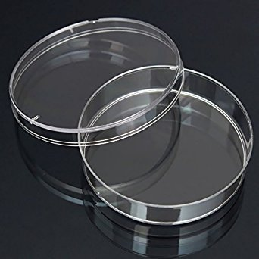
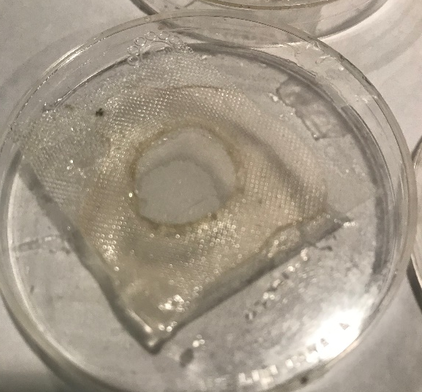
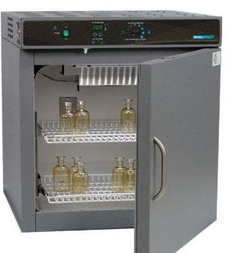
Task 5
Go over set up in how to investigate individual fly species and effects of environment on developmental cycle in controlled environments.
Incubator of set temperature and lighting
Ease in varying temp (day/night), rain etc..
Ease of taking photos of stages from the dishes.
Ease in varying or comparing effects of food source

Slide 34
Examine the effect of
different forms of LPS
Examine the effect of
different concentrations of LPS
EGG laying
Adult selectivity
and
Larval selectivity
Examine the effect of
Eating different forms of LPS
Examine the effect of eating
different concentrations of LPS

Slide 35
Examine the effect of
different forms of LPS
Examine the effect of
different concentrations of LPS
EGG laying
Adult selectivity
and
Larval selectivity
Examine the effect of
Eating different forms of LPS
Examine the effect of eating
different concentrations of LPS

